Slide 1
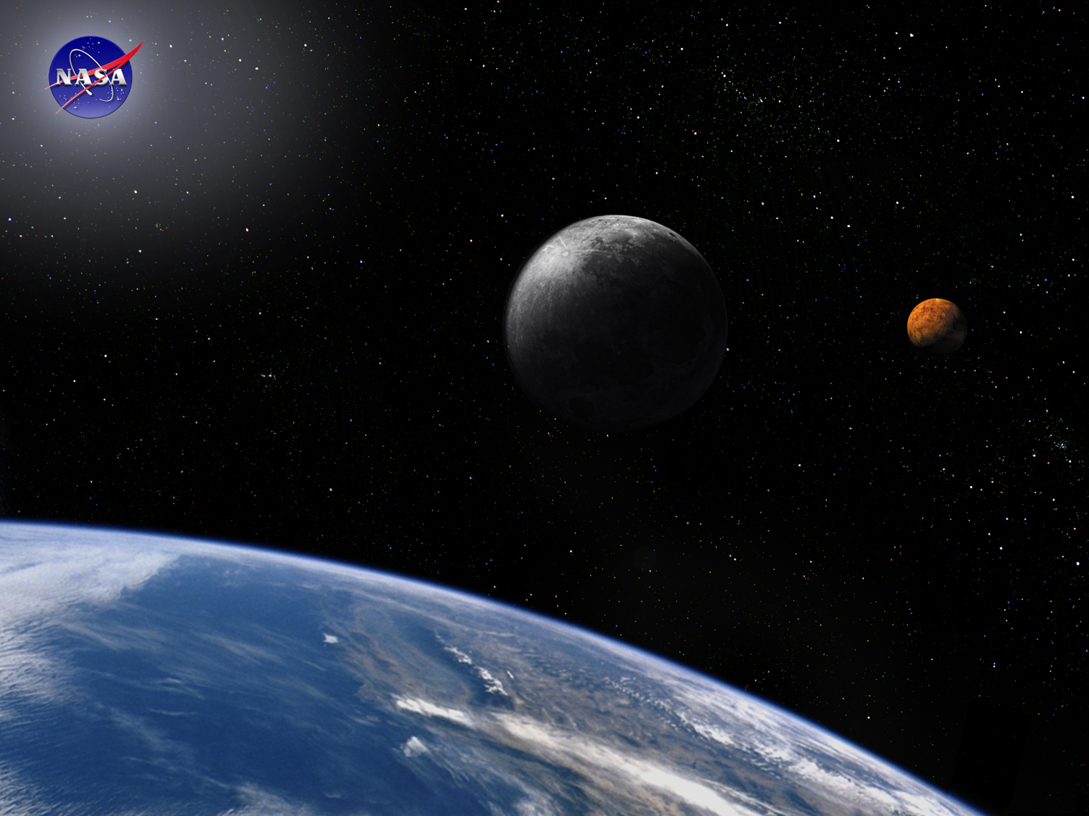
Requirements Module:
The Basics
Space Systems Engineering, version 1.0
Notes:
Version 1.0
SOURCE INFORMATION:
The material contained in this lecture was developed by Lisa Guerra of NASA’s Exploration Systems Mission Directorate while on assignment in the Department of Aerospace Engineering at the University of Texas at Austin. As part of a course entitled, Space Systems Engineering, the lecture was piloted at UT-Austin in Spring 2008.
The content that follows was also reviewed and edited by Dr. Paul Graf, Adjunct Professor at the University of Colorado at Boulder.

Slide 2
Module Purpose: Requirements - The Basics
Establish the role of good requirements in project success.
  Requirements capture the understanding of what is to be done.
Establish the significance of good requirements development.
  Poor requirements are the single biggest problem for projects.
  The later a problem is discovered the more costly it is to recover from.
Describe the different types of requirements.
Establish how requirements are distributed — allocation, flow-down and derived.
Define and understand the value of requirements traceability.
Recognize that system decomposition creates new interfaces that must be defined and owned.

Slide 3
The Importance of Requirements
Requirements problems are the single biggest cause of project problems.
Requirements define what is to be done, how well and under what constraints - get the requirements wrong and the design and hardware will be wrong.
Requirements drive…
  Cost - Design - Schedules - Skills required - Verification plans - Operational procedures - everything
It is amazing how many teams begin to solve a problem before there is agreement on what the problem is. Requirements and their associated constraints and assumptions quantify the problem to be solved - they establish how project success will be determined.

Slide 4
What is a Requirement?
Statement of some THING you want or need
OR
A characteristic of some THING you want or need
A requirement is also…
  A Contractually Binding Statement
  Documentation of Problem Space
  The Means We Use to Communicate
Mutual
Understanding

Slide 5
The Importance of Getting the Requirements Right
Requirement and concept development commit costs before they are incurred.
100
Costs Committed
80
Cost (%)
60
Costs
Incurred
40
20
0
Requirement
and Concept
Development
Detailed
Design
Production 
Time
Notes:
After Blanchard and Fabrycky; Systems Engineering and Analysis; 4th ed, 2006; figure 2.12 page 46
Note: x-axis is labeled to capture a 80% committed vs. 20% expended at the start of production – typical of a
multi-build project

Slide 6
The Cost of Error Recovery or a Requirements Change Increases Dramatically with Project Phase
Why requirements change:
New requirements are added or discovered
Priorities change
New understanding of the difficulties of an implementation approach
Measured performance does not meet required performance
10,000
1,000
Cost to Fix an Error or Change a Requirement
100
10
1
Requirements
Analysis
Design
Fabrication
IV & V
Operations &
Maintenance
Project Phase
Notes:
Stylized interpretation of quantified data from software projects
Slide 6 the cost of changing a requirement also grows rapidly with project phase

Slide 7
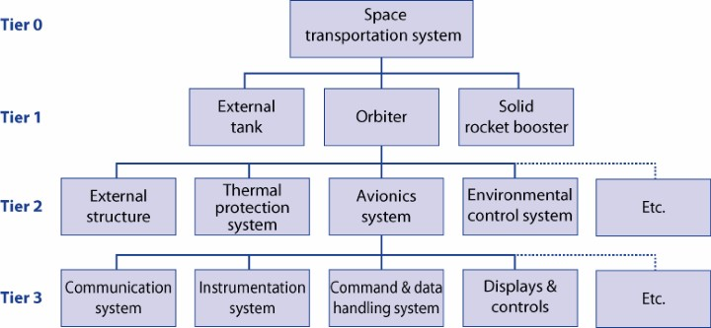
Where Do Requirements Come From?
At the highest level, from your scoping exercise
Stakeholder and Customer need statement
Defined goals and objectives
Assumptions and constraints
Concept of Operations
Project analysis and trade studies
Figures of merit
Project system hierarchy
What functions must the system and subsystem do to perform the mission?

Slide 8

Requirements Also Come From Organizational Standards and Government Regulations
Guiding Documents, such as
NASA Procedural Requirements
  NPR 8020.12C “Planetary Protection Provisions for Robotic Extraterrestrial Missions”
  NPR 8705.2A “Human-rating Requirements for Space Systems”
Launch Vehicle payload/user requirements
Standards-based Requirements
Regulation Requirements (e.g. DOE nuclear standards)
Further operational considerations
System boundaries and external interfaces
  Are other systems driving some of your design requirements, like interfacing with the International Space Station?
The operating and supporting environments
  What requirements does the space environment impose on your system?
Use of legacy systems
  What requirements originally designed to?

Slide 9
Requirements Development
Is the Most Important Step!
Requirements are distributed from the broad mission scope into the architecture that defines the project
Requirements bound the scope of the problems to be solved so we know when we have done well enough
A hierarchy of traceable requirements ensures that the project is building only what is required, i.e., no frivolous activities
A hierarchy of negotiated requirements ensures a balanced system design
Requirements are the basis for the project’s verification and validation efforts
  Poorly written or unverifiable requirements are trouble!

Slide 10
Requirements are Decomposed
Following the Functional Architecture
Requirements are decomposed via three methods — flow-down, allocation and derivation.
Requirement flow-down is a direct transfer since a subsystem provides the capability.
  E.g., The requirements for spacecraft communications may be entirely flowed-down from the spacecraft system requirements to the spacecraft communications subsystem requirements.
Allocation is a quantitative apportionment from a higher level to a lower level and for which the unit of measure remains the same. Examples include mass, power, or pointing.
  A 1,000 kg spacecraft may allocate 200 kg, 500 kg and 300 kg to its three subsystems.
  Not always a linear combination - e.g., system pointing performance is typically combined via Root-Summed-Squared (RSS).

Slide 11
Requirements are Decomposed
Following the Functional Architecture
Requirement derivation is an apportionment that depends on the specific implementation.
  E.g., A car may have a 0-100 kph performance requirement that is used to establish a requirement for a maximum mass and a minimum horsepower.
  Or a launch vehicle’s performance might establish a maximum satellite mass for a given altitude and orbital inclination.

Slide 12
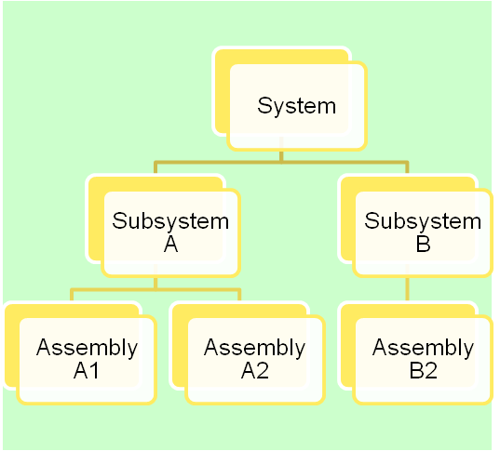
Requirements Traceability and Hierarchy
Once mission level requirements have been decomposed to lower levels, traceability identifies the relationship between requirements.
Knowing the source and dependencies between requirements is valuable since if a requirement changes, traceability can be used to determine the implications of that change.
Total
Solution
Level 1
Level 2…
Level 3
Reqt 1.0
Level 1
Reqt 2.1
Level 2
Reqt 2.0
Reqt 2.2
Reqt 2.3
…
Reqt 2.3.1
Reqt 2.3.2
Level 3
Reqt 3.1.1
Reqt 3.0
Reqt 3.1
…
Reqt 3.1.2
Reqt 3.1.3
…
Reqt 3.1.4
Notes:
9903

Slide 13
Types of Requirements
Functional - Requirements which define what an item must do.
  The system shall provide communications between the ground and the spacecraft.
Performance - Requirements which define and quantify how well an item must accomplish a particular function.
  Provide communications over what range, with what data rate and how often
Constraints - Requirements that capture operational, environmental, safety or regulatory constraints.
  The communications system shall use X-band frequencies.
  The communications system shall operate with a base plate temperature of at least -30 C and at most 40 C.
  The maximum RF power density shall be less than 10 watts/m²
  Design standards (e.g., metric units, programming language, etc.)
Verification - Requirements capture how confidence will be established that the system will perform in its intended environment.
  All performance and functional requirements shall be met while the system is in a vacuum chamber with 2.5 Kwatts/m² of visible light illuminating the z-side.
Notes:
Source: Goddard Green Book; NASA Engineering Management Council (EMC) 1992

Slide 14
Crew Exploration Vehicle (CEV) Requirements Distribution, example
System Performance Requirements Document
  The CEV System shall provide two-way voice communications during crewed operations.
Flight Segment Performance Requirements Document
  The flight segment shall provide voice communications to the ground through TDRSS.
  Other derived requirements.
Flight Vehicle Contract End Item Specification Part I
  The flight vehicle shall provide four omni directional antennas.
  The flight vehicle shall provide two S-Band transponders.
  The flight vehicle shall provide a switch matrix to allow connection of each S-Band transponder with each omni directional antenna.
  Other derived requirements.
Flight Vehicle Contract End Item Specification Part II
  The communications subsystem shall provide the equipment specified in drawing CEVFV-COM1-234.
  The communications subsystem shall be wired as shown in drawing CEVFV-COM2-234.
  The communications subsystem equipment shall be mounted on the avionics pallets as shown in drawing CEVFV-COM2-235.
  Other derived requirements.
System Functional
Performance
Requirements
Segment Functional
Performance
Requirements
Element
Design
Requirements
Element
Fabrication
Requirements

Slide 15
Requirement Families
System
If parent requirements are…
  INCOMPLETE
  INCORRECT
  AMBIGUOUS
  CONFLICTING, or
  UNVERIFIABLE
Then…children and subsequent generation requirements will be progressively worse.
Requirement
Parent
Children
Subsystem
Subsystem
Peers
Requirement
Requirement
Requirement
Parent
Element
Requirement
Child

Slide 16
The Decomposition of a System Also Creates Interface Requirements
System
There can be interfaces between each subsystem and between each subsystem and the system.
The functions, performance, assumptions and constraints of these interfaces much be defined and captured in interface requirements.
Interface ownership must be established - since the responsible individual or organization for an interface is not always obvious.
Requirement
Interface Requirements
Subsystem
Subsystem
Requirement
Requirement
Requirement
Interface Requirements
Element
Requirement

Slide 17
Key Interface Documents
Interface Definition Document (IDD) - defines interfaces to an existing system such as a launch vehicle. It says what interface someone else must meet to use the launch vehicle. Can be anything, such as mass, type of connector, EMI…
  Owned by manager of the system with which you want to interface
  Probably not going to change
Interface Requirement Document (IRD) - defines interfaces for two developing systems. Includes both physical and functional interfaces and ensures hardware & software compatibility.
  Jointly managed (NEEDS ONE OWNER) and signed by the managers of the two systems in development.
Interface Control
Document (ICD) -
Identifies the design
solution for the physical
interface (drawings).
Environment
Other
System
Interfaces
IRDs
System of
Interest
IDD
Other
System
LV
System

Slide 18
Pause and Learn Opportunity
View the James Webb Space Telescope (JWST) requirements hierarchy (JWST requirements flow down tree.pdf) as an example of the layers of requirements and relationships throughout the system.

Slide 19
Module Summary: Requirements — The Basics
Requirements define the problem to be solved and establish the terms by which mission success will be measured.
Requirements problems are the single biggest problem on development projects so care in creating good requirements always pays off.
The later a problem is discovered the more costly it is to recover from.
Requirements are distributed within the system architecture via flow-down, allocation and derivation.
Requirements traceability is a technique of tracking the source and connections between requirements. It is used to assess the consequences of potential requirements changes.
When a system is decomposed into smaller segments, interfaces are created that must be defined and managed.

Slide 20
Backup Slides for Requirements — the Basics Module

Slide 21
Importance of Requirements
Nov 30, 2007
1. GAO recommends NASA shore up Ares I business case. The U.S. Government Accountability Office (GAO) is recommending that NASA not proceed beyond the 2008 preliminary design review (PDR) for the Ares I Crew Launch Vehicle until it establishes a sound business case for the program. "NASA has not yet developed the knowledge needed to make sound investment decisions for the Ares I project," GAO says in a new report. "Principally, there are gaps in knowledge about requirements, costs, schedule, technology, design, and production feasibility." Ares I PDR is expected in late summer or early fall of next year (See related charts below and pp. 7-8). Derived from a five-segment version of the space shuttle's solid rocket booster, the Ares I will boost the Orion Crew Exploration Vehicle to orbit for missions to the International Space Station and the moon. Ares I is set to begin launching operational Orion missions in early 2015. GAO estimates the total price tag for NASA's exploration program over the next two decades at nearly $230 billion. GAO called the Ares I program's gaps in needed knowledge for an informed PDR "fairly significant and challenging given the complexity and interdependencies in the program." As an example of such interdependency, GAO cited "continued instability" in the design of the Orion, which is hampering the Ares program's efforts to firm up their own requirements. Orion has undergone several design revisions in an attempt to keep the spacecraft within desired weight margins, although NASA officials have said those problems are nearly solved (DAILY, Oct. 3). NASA says at least 14 of the 57 risks identified in the Ares projects are "explicitly tied" to requirements instability. On top of this, three major elements of Ares I - the first stage, the upper stage and the Apollo-derived J- 2X upper stage engine - pose "significant development challenges," according to GAO. The J-2X is a new engine development effort, and NASA estimates it will require 29 rework cycles to fix developmental problems. Still, GAO cited NASA's progress in trying to build a business case for the program, including relying on established technology and adopting an acquisition strategy that emphasizes gaining knowledge on cost, schedule and technical feasibility before making significant procurement commitments. NASA agreed with its recommendation not to move beyond PDR until the program's business case improves, according to GAO. "The program also acknowledges that many risks are present and is undertaking an array of activities to track and mitigate those risks," GAO says. "However, NASA has not yet developed the knowledge needed to make sound investment decisions for the Ares I project." GAO's review was requested by Rep. Bart Gordon (D-Tenn.), chairman of the House Science and Technology Committee. Commenting on the report, Gordon promised more lawmaker scrutiny of NASA's exploration plans, saying, "The Administration has undertaken a major new Exploration initiative on a 'business as usual' budget, and that's going to make it difficult for NASA to succeed." - Jefferson Morris (jeff_morris@aviationweek.com)

Slide 22

Types of Requirements
  Stakeholder Expectations
    Musts
    Wants
  System Requirements
    What the system must do
    Prioritized “wants”
  Imposed Requirements
    Environmental Requirements
    Standards-based Requirements
  Interface Requirements
  Regulation Requirements
  Implementation Requirements
  Verification Requirements
Do we have ALL the requirements?
Notes:
9903
5
Wants or objectives are discussed in the concept exploration phase and they either are or are not included to create the system requirements

Slide 23
Constraints
Constraints such as external interfaces imposed by other systems; the storage, transportation, and operating environments (terrestrial or space) such as temperature, electromagnetic, and; and the threat imposed by known or potential enemy capabilities also limit the range of practical design concepts. Note that the precise character of these constraints may depend on the proposed solution. As an example, one set of capabilities might lead to a design concept that might in turn result in a satellite weight within the capability of one launch system (such as the Delta II) and its interface constraints while more demanding capabilities might lead to a satellite requiring a more capable launch system (Atlas V or Delta IV) having a different interface, such as a vibration environment. The range of potential threats is also likely to depend on the design solution.
Also, policy and public law (legal constraints) involving factors such as environmental impact and safety hazards are important to understanding which concepts will be useful and practical.
When a system is being acquired to replace an existing system, the plan for transitioning from the current system may place additional constraints on the concept and program (such as the schedule for the current system to be retired).
Notes:
Source: SMC SE Primer AR p.38

Slide 24
Levels of Requirements
Increasing
Level of
Detail
Increasing
Levels of
Management
System
Segment
Element
Subsystem

Slide 25
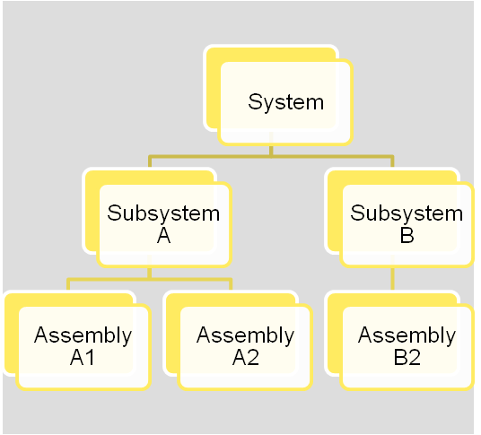
Requirements Hierarchy
  Requirements are established for every entity in the system hierarchy – the Product Breakdown Structure (PBS).
  The Product Breakdown Structure reflects the system architecture.
  A Requirements Document must be established for each entity in the PBS.
  There should be an individual responsible for each Requirements Document.
Product Breakdown Structure
Notes:
9903

Slide 26
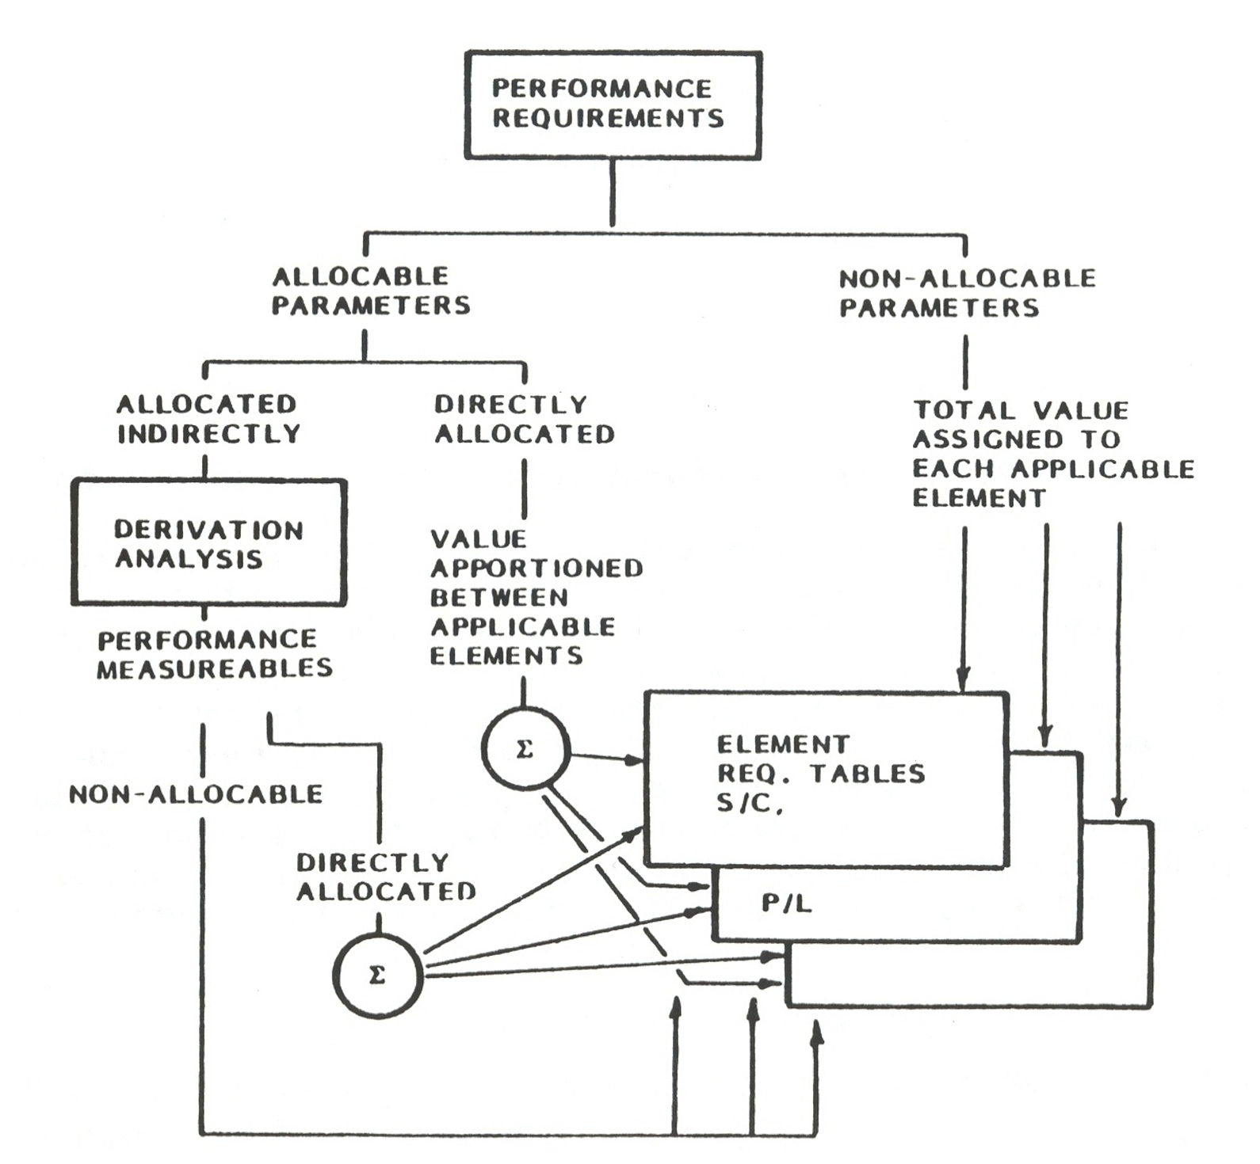
Requirements Allocation
Usually Occurs in Functional Analysis, Decomposition, and Synthesis
But Worth Addressing Because Anticipating that Your Requirements Will be Allocated Helps Create Better Requirements
Improperly Written Requirements are Very Difficult to Allocate

Slide 27
Requirements Flow down - An Analogy
Functional/Mission
Functional/Performance
Design
End-Item Part I
End-Item Part II
TRANSPORTATION
  To/from work
  To/from store, cleaners, etc.
  Available 7 days per week
  Trips > 100 miles
  Ease of maintenance
  3 or more persons
  Cost constraint = $X/yr
A CAR
  Mid-size
  Trunk
  4-door
MAKE-MODEL
  Toyota
  Camry
ACCESSORIES
  AM/FM Radio
  Air Conditioning
  Built-in child seat

Slide 28
Derived Requirements & Synthesis
Directly support mission requirements
Traceable Requirements:
In practice, you don’t know ahead of time what your design solution will be…
System requirements
Internal and External Constraints
Physical
Functional
Operational
Performance specifications
Mission design
Concept of operations
Functional Analysis
Derived Requirements
Subsystem requirements
Component Specifications
Interface Definitions
Synthesis
Bottom Line:
Organized top-down thinking process
Write a formal requirements document

